Slide 1
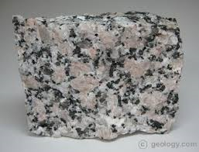
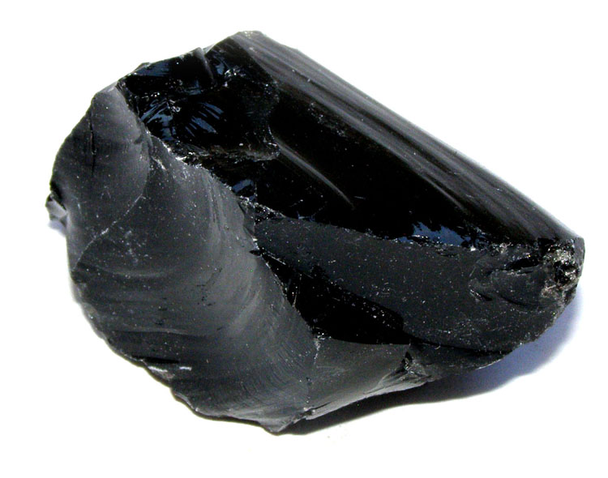
Daily Review
Intrusive igneous rocks are formed when magma cools slowly underground forming large crystals.
Extrusive igneous rocks are formed when lava cools quickly above ground forming small or no crystals.
How is an intrusive igneous rock different to an extrusive igneous rock?
Obsidian
Granite

Slide 2
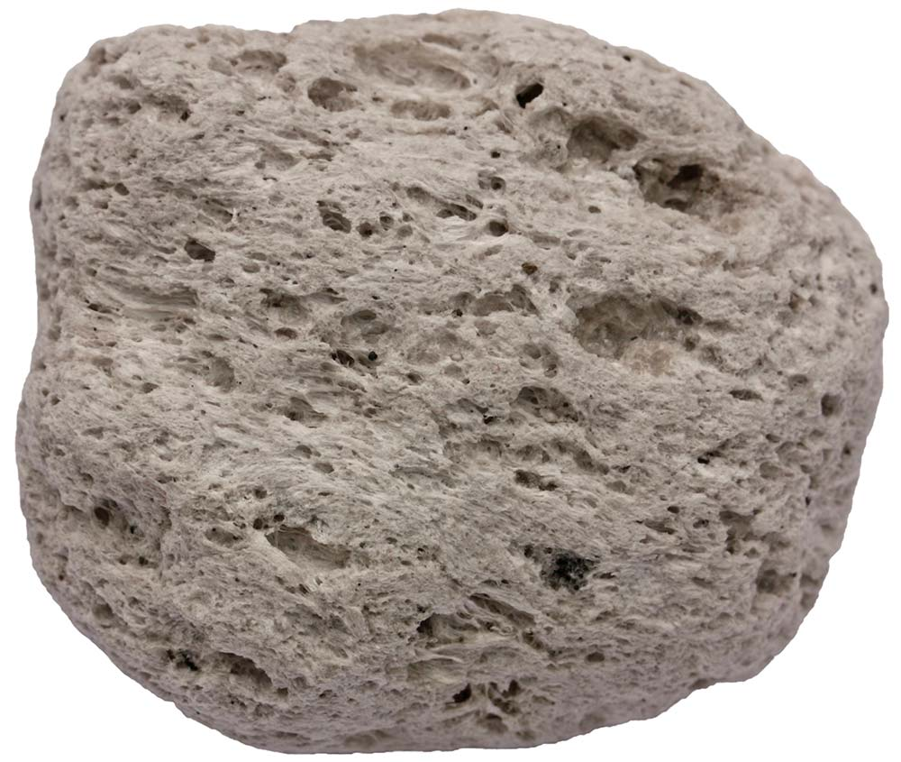
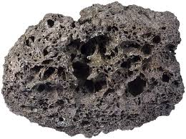
Daily Review
Some extrusive igneous rocks form from gaseous lava.
Which of these extrusive igneous rocks formed from gaseous lava? Explain your choice.
Pumice
Obsidian
Scoria

Slide 3
Daily Review
CFU 1
Are there large crystals?
CFU 2
Are there small or no crystals?
Identifying Igneous Rocks
1. Large crystals visible with the naked eye = intrusive igneous 2. Small or no crystals? Air holes = extrusive igneous from gaseous lava No air holes = extrusive igneous from non-gaseous lava
CFU 3
Does it have air holes?
Pumice
Pumice is an extrusive igneous rock. It has small crystals and formed quickly above ground from gaseous lava.

Slide 4
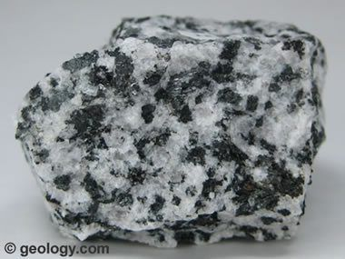
Daily Review
CFU 1
Are there large crystals?
Diorite
CFU 2
Are there small or no crystals?
Identifying Igneous Rocks
1. Large crystals visible with the naked eye = intrusive igneous 2. Small or no crystals? Air holes = extrusive igneous from gaseous lava No air holes = extrusive igneous from non-gaseous lava
CFU 3
Does it have air holes?
Diorite is an intrusive igneous rock. It has large crystals and formed slowly underground.

Slide 6
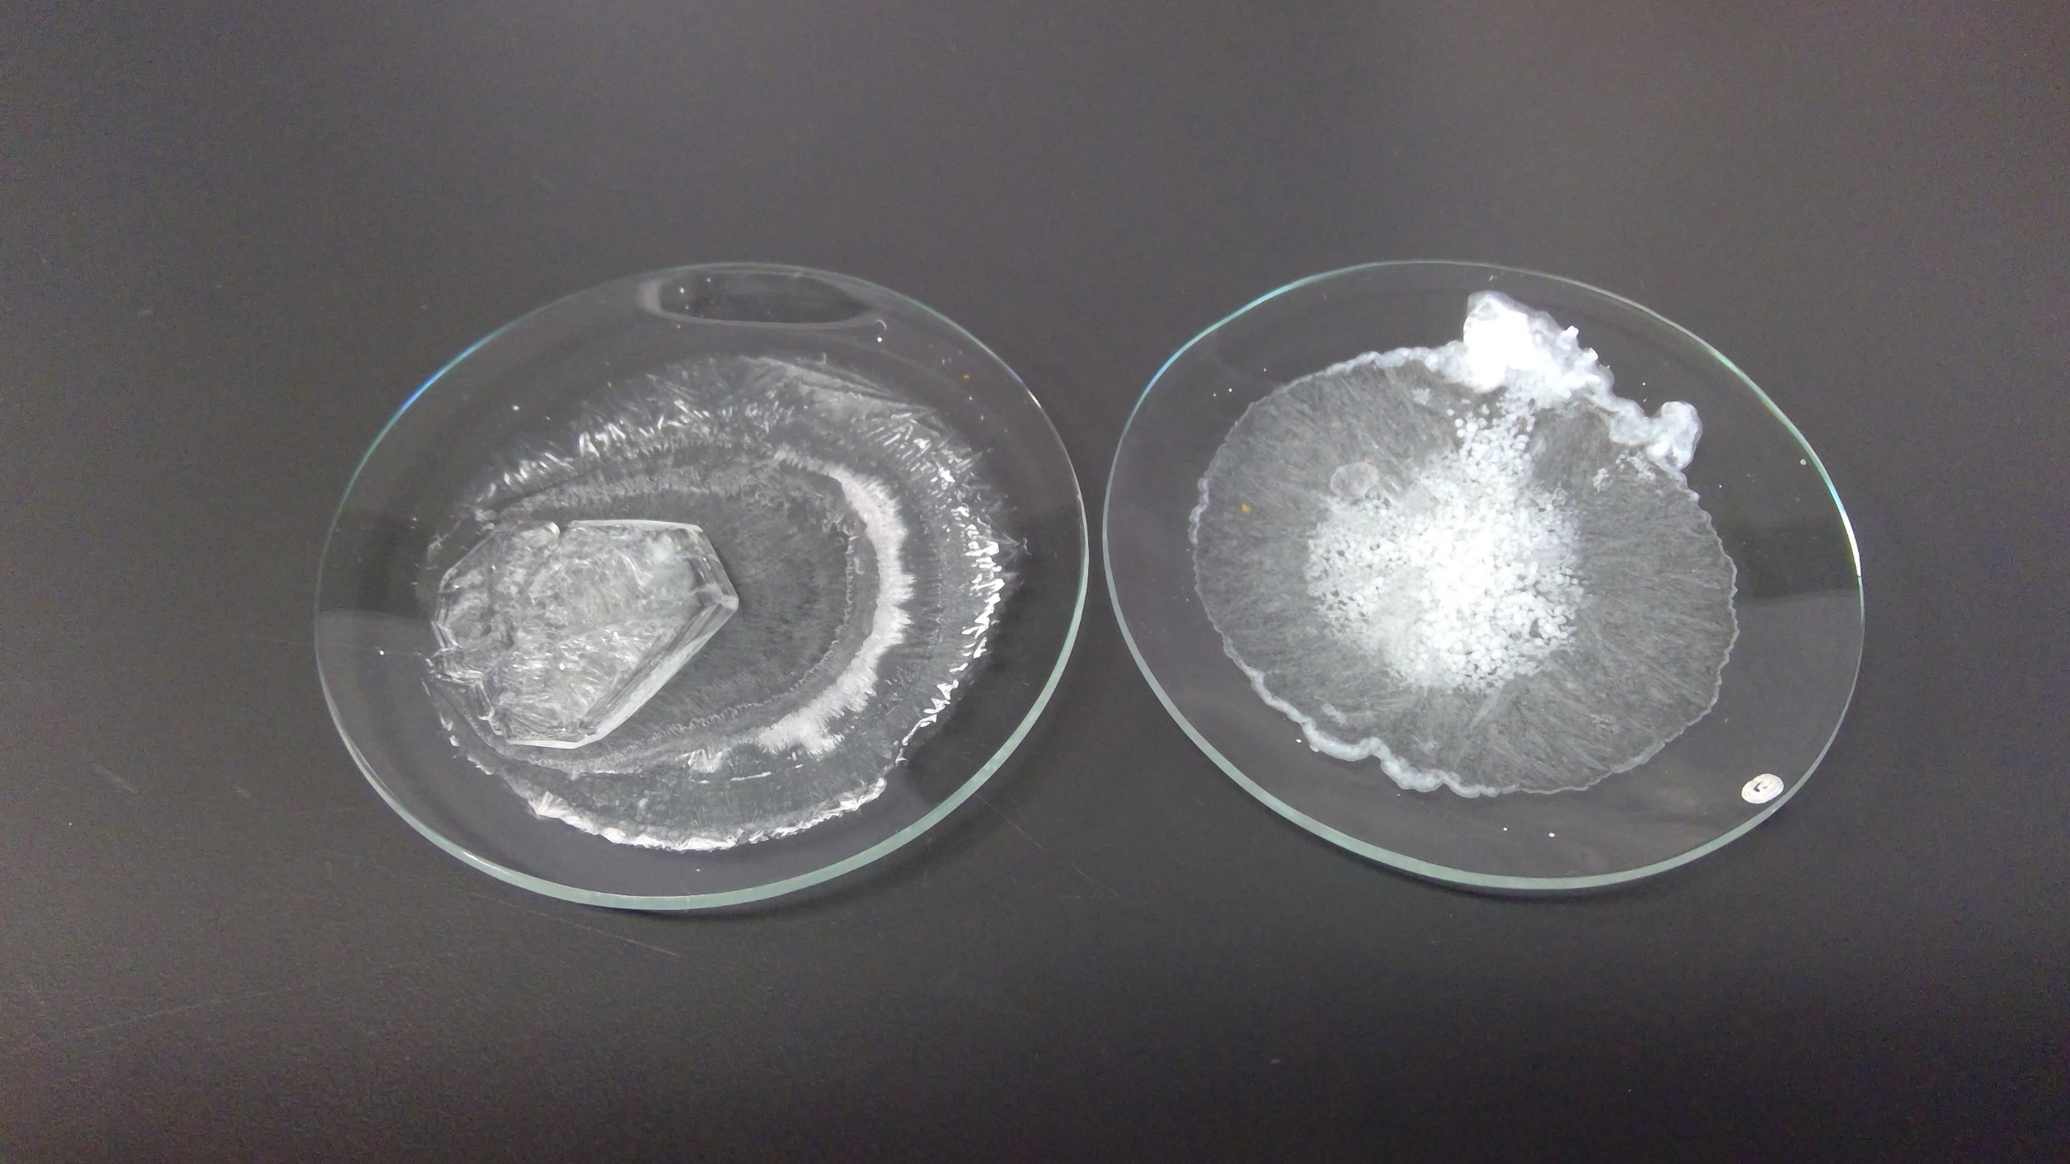
Expected Experiment Results
Cooled slowly over hot water bath
Cooled quickly over ice bath

